Slide 1
Elements and Tags

Slide 2
The <!DOCTYPE html> declaration defines that this document is an HTML5 document
The <html> element is the root element of an HTML page
The <head> element contains meta information about the HTML page
The <title> element specifies a title for the HTML page (which is shown in the browser's title bar or in the page's tab)
The <body> element defines the document's body, and is a container for all the visible contents,
such as headings, paragraphs, images, hyperlinks, tables, lists, etc.
The <h1> element defines a large heading
The <p> element defines a paragraph

Slide 3
What is an HTML Element?
An HTML element is defined by a start tag, some content, and an end tag:
<tagname> Content goes here... </tagname>
The HTML element is everything from the start tag to the end tag:
<h1>My First Heading</h1>
<p>My first paragraph.</p>

Slide 4
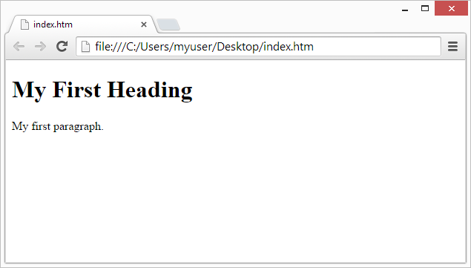
Web Browsers
The purpose of a web browser (Chrome, Edge, Firefox, Safari) is to read HTML documents and display them correctly.
A browser does not display the HTML tags, but uses them to determine how to display the document:

Slide 5
HTML Page Structure
<html>
<head>
<title>Page title</title>
</head>
<body>
<h1>This is a heading</h1>
<p>This is a paragraph.</p>
<p>This is another paragraph.</p>
</body>
</html>

